Slide 1
C12
Memory Allocation
TLPI, Chapter 7

Slide 2
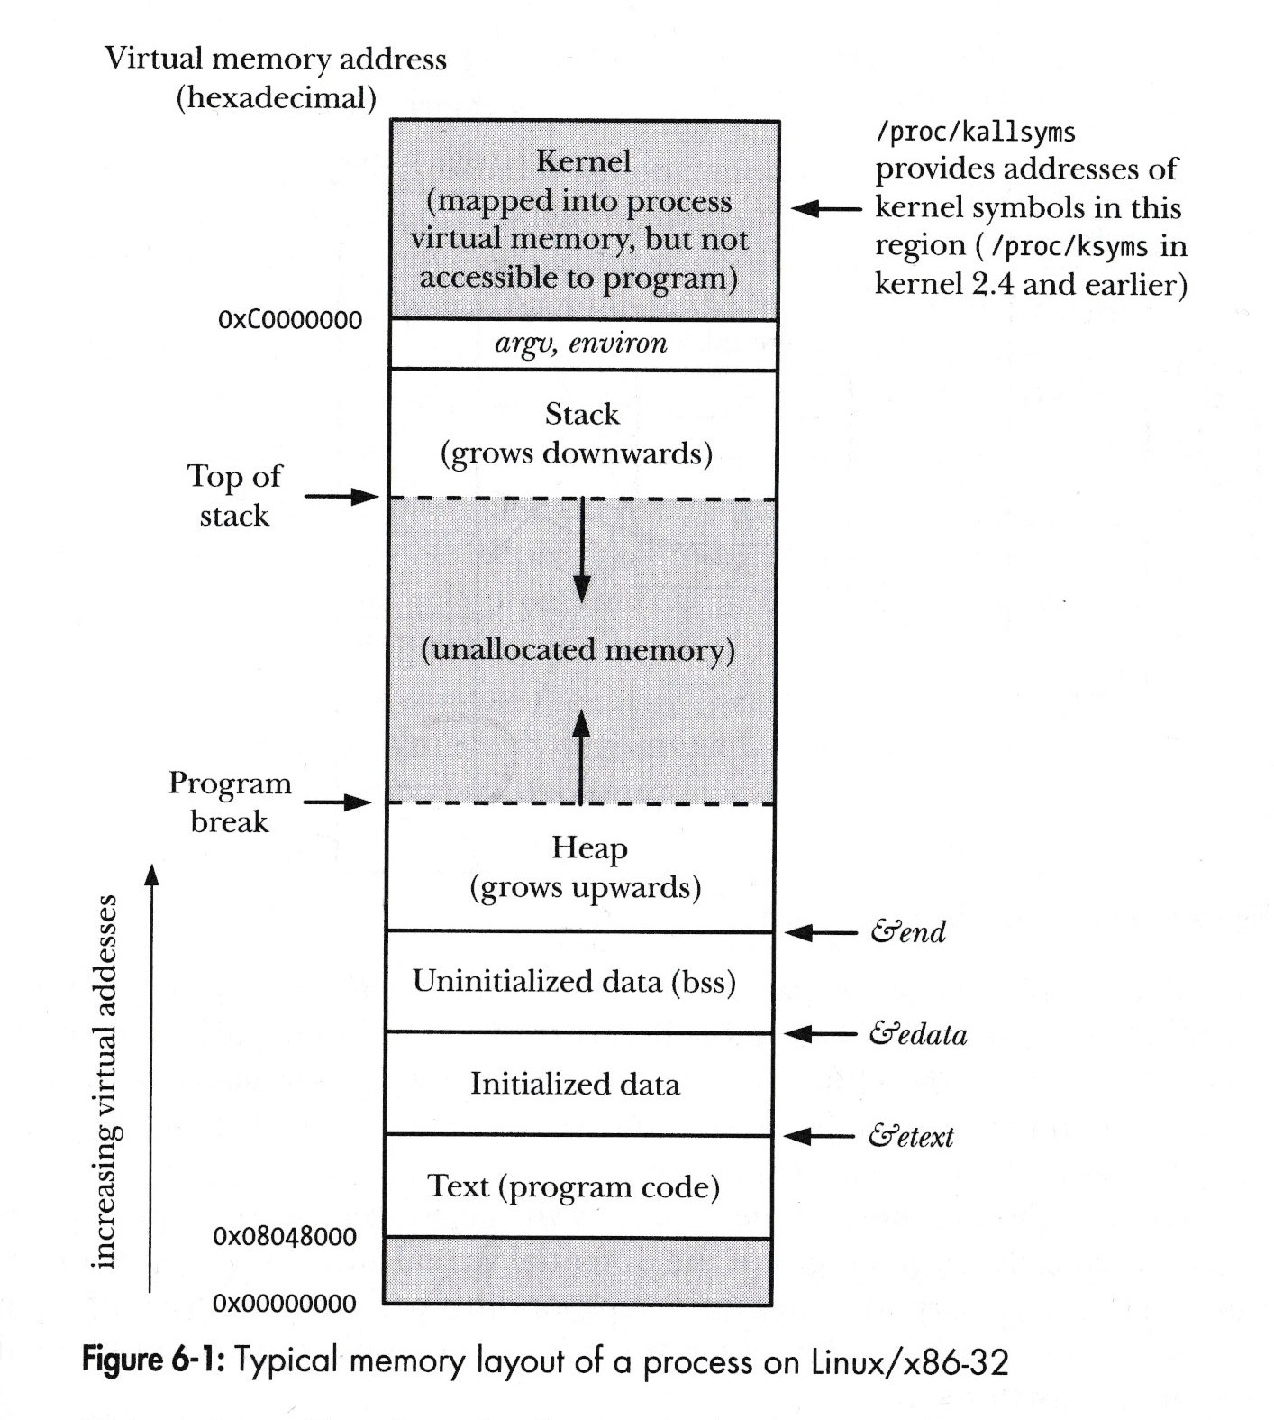
Typical
Memory
Layout
of a
Process
TLPI, Page 119

Slide 3
Why do we need to allocate Memory
Some programs need to deal with linked lists and/or binary trees. Their size is not always known at design time.
Dynamic Memory Allocation will help us deal with this situation.
It will allow a program to obtain more memory space at run time to hold new nodes, and then release space no longer needed.

Slide 4
Allocating Memory on the Heap malloc() and free()
These functions:
Are standardized as part of the C language
Are easier to use in threaded programs
Provide a simple interface that allows memory to be allocated in small units, and
Allow us to arbitrarily deallocate blocks of memory, which are maintained on a free list and recycled in future calls to allocate memory.

Slide 5
Allocating Memory on the Heap
#include <stdlib.h> // a C function call
void *malloc (size_t size)
Returns pointer to allocated memory on success,
or NULL on error.
This function allocates size bytes from the heap and returns a pointer to the start of the newly allocated block of memory
The allocated memory is not initialized.
malloc() returns a void*, so we can assign it to any type of C pointer.

Slide 6
…more on malloc()
The block of memory returned by malloc() is always aligned on a byte boundary suitable for efficient access to any type of C data structure.
In practice, this means that it is allocated on an 8-byte or 16-byte boundary on most architectures.
malloc() should be error checked.

Slide 7
free
#include <stdlib.h> // a C function call
void free(void *ptr);
This function adds the block of memory to a list of free blocks that are recycled by future calls to malloc()

Slide 8
Memory Leak
If we are writing a long-running program (e.g., a shell or a network daemon process) that repeatedly allocates memory for various purposes, then we should ensure that we deallocate any memory after we have finished using it.
Failure to do means that the heap will steadily grow until we reach the limits of available memory, at which point further attempts to allocate memory fail.
Such a condition is known as a memory leak.

Slide 9
Use after free()
Making any use of a ptr after the call to free()
-- for example, passing it to free() a second time
– is an error that can lead to unpredictable results.

Slide 10
free() the wrong thing.
Do not attempt to free() a variable that is not allocated by one of the memory allocation functions:
malloc(), calloc(), realloc().

Slide 11
Code Example in TLPI book
Page 142-143. malloc, free, sbrk

Slide 12
C12
Memory Allocation
The End

